Slide 1
CASE STUDY 2 – MSDS 6306
Jonathan Flores, Melissa Luzardo and Randy Park

Slide 2

DDS Analytics – “Attrition” Predictive Model
Project Description:
DDS executive leadership has identified predicting employee turnover as its first application of data science for talent management.
Request:
The team is tasked our data science team to conduct an analysis of existing employee data.

Slide 3
Methodology to make prediction model using lra
Predictions
Model Creation
Exploratory Data Analysis
Explore: Attrition vs All Variables
Try to find important variables and relevant trends
Clean and transform the information to a numeric data set
Evaluate Prediction Models against requirements
Split data set into training and data set
Create model and Reduced Model
Create Predictions using testing data set
Cross validation with testing data set
Study Results

Slide 4
Exploratory Data Analysis

Slide 5
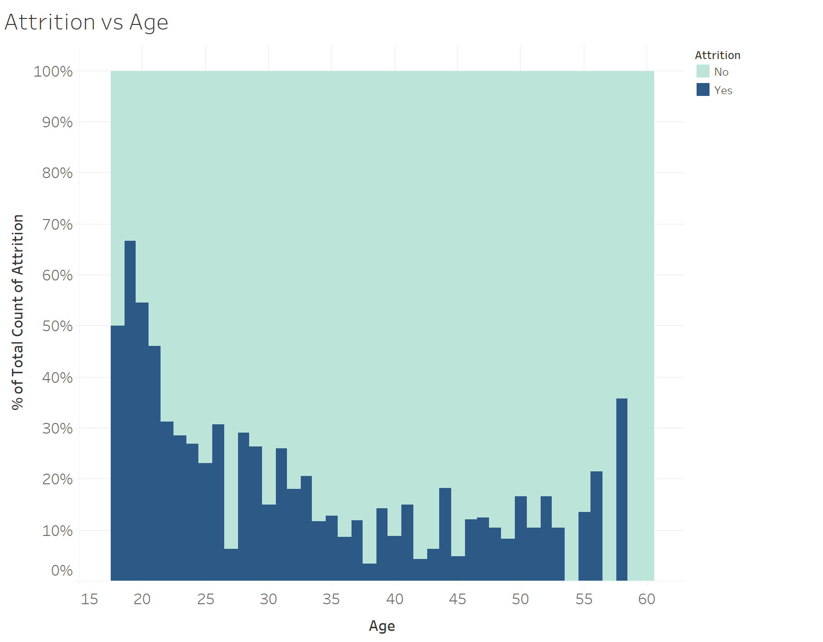
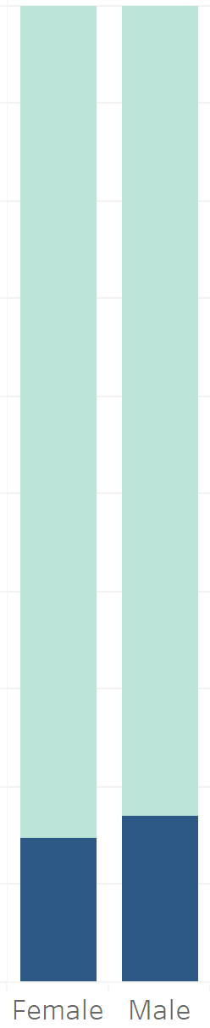
Attrition insights -
Attrition vs Age
Attrition vs Gender
Employees in the ages from 18 to 21 tend to quit their job more than employees in different ages
When looking attrition by Gender in isolation, it seems like there is not much difference

Slide 6
predictive model and variable prioritization

Slide 7
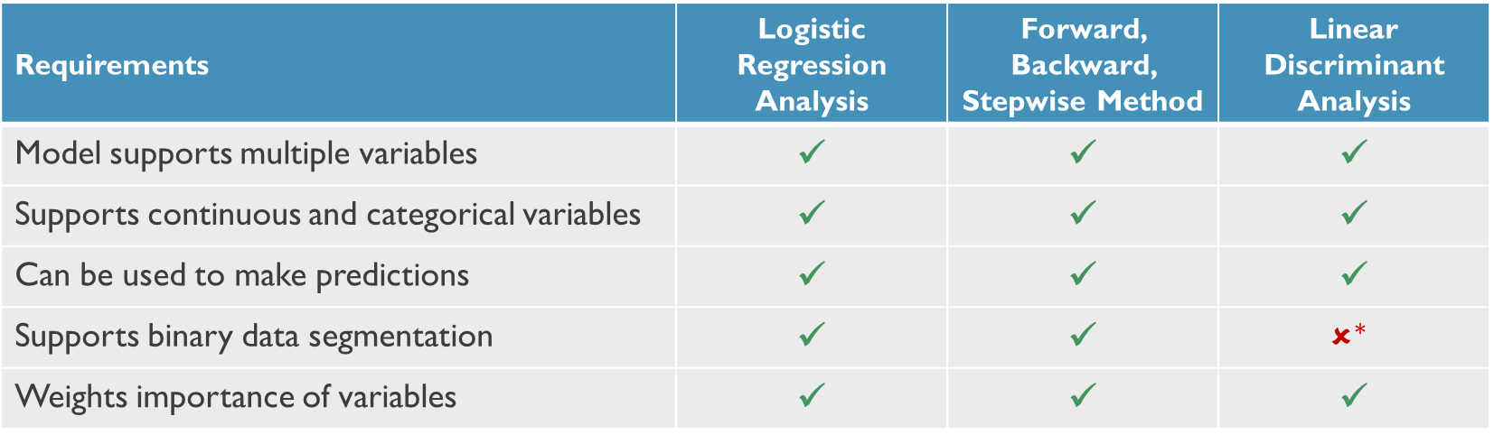
model Requirements, evaluation and comparison
Multiple models were reviewed and 3 of them met the met most of the requirements. Logistic Regression Analysis gave the best results
Requirements | Logistic Regression Analysis | Forward, Backward, Stepwise Method | Linear Discriminant Analysis
Model supports multiple variables | ✓ | ✓ | ✓
Supports continuous and categorical variables | ✓ | ✓ | ✓
Can be used to make predictions | ✓ | ✓ | ✓
Supports binary data segmentation | ✓ | ✓ | $$✗^{∗}$$
Weights importance of variables | ✓ | ✓ | ✓
*It is possible to use LDA model for binary predictions; however, LDA is best suited for more than two categorical predictions
Notes:
All models can predict attrition given our data set. Selected the logistic regression analysis.
Both LRA and F/B/S methods are probability models. Only LDA is a machine learning model

Slide 8
Logistic Regression analysis

Slide 9
appendix

Slide 10
Executive summary
Analysis Repository
Data Set
Data set contains 32 variables (including attrition)
Analysis
Please see analysis repository in R, for details
Predictive Model
1,470 observations
The data set contains discrete, continuous and categorical variables
17 variables are categorical

